Slide 1
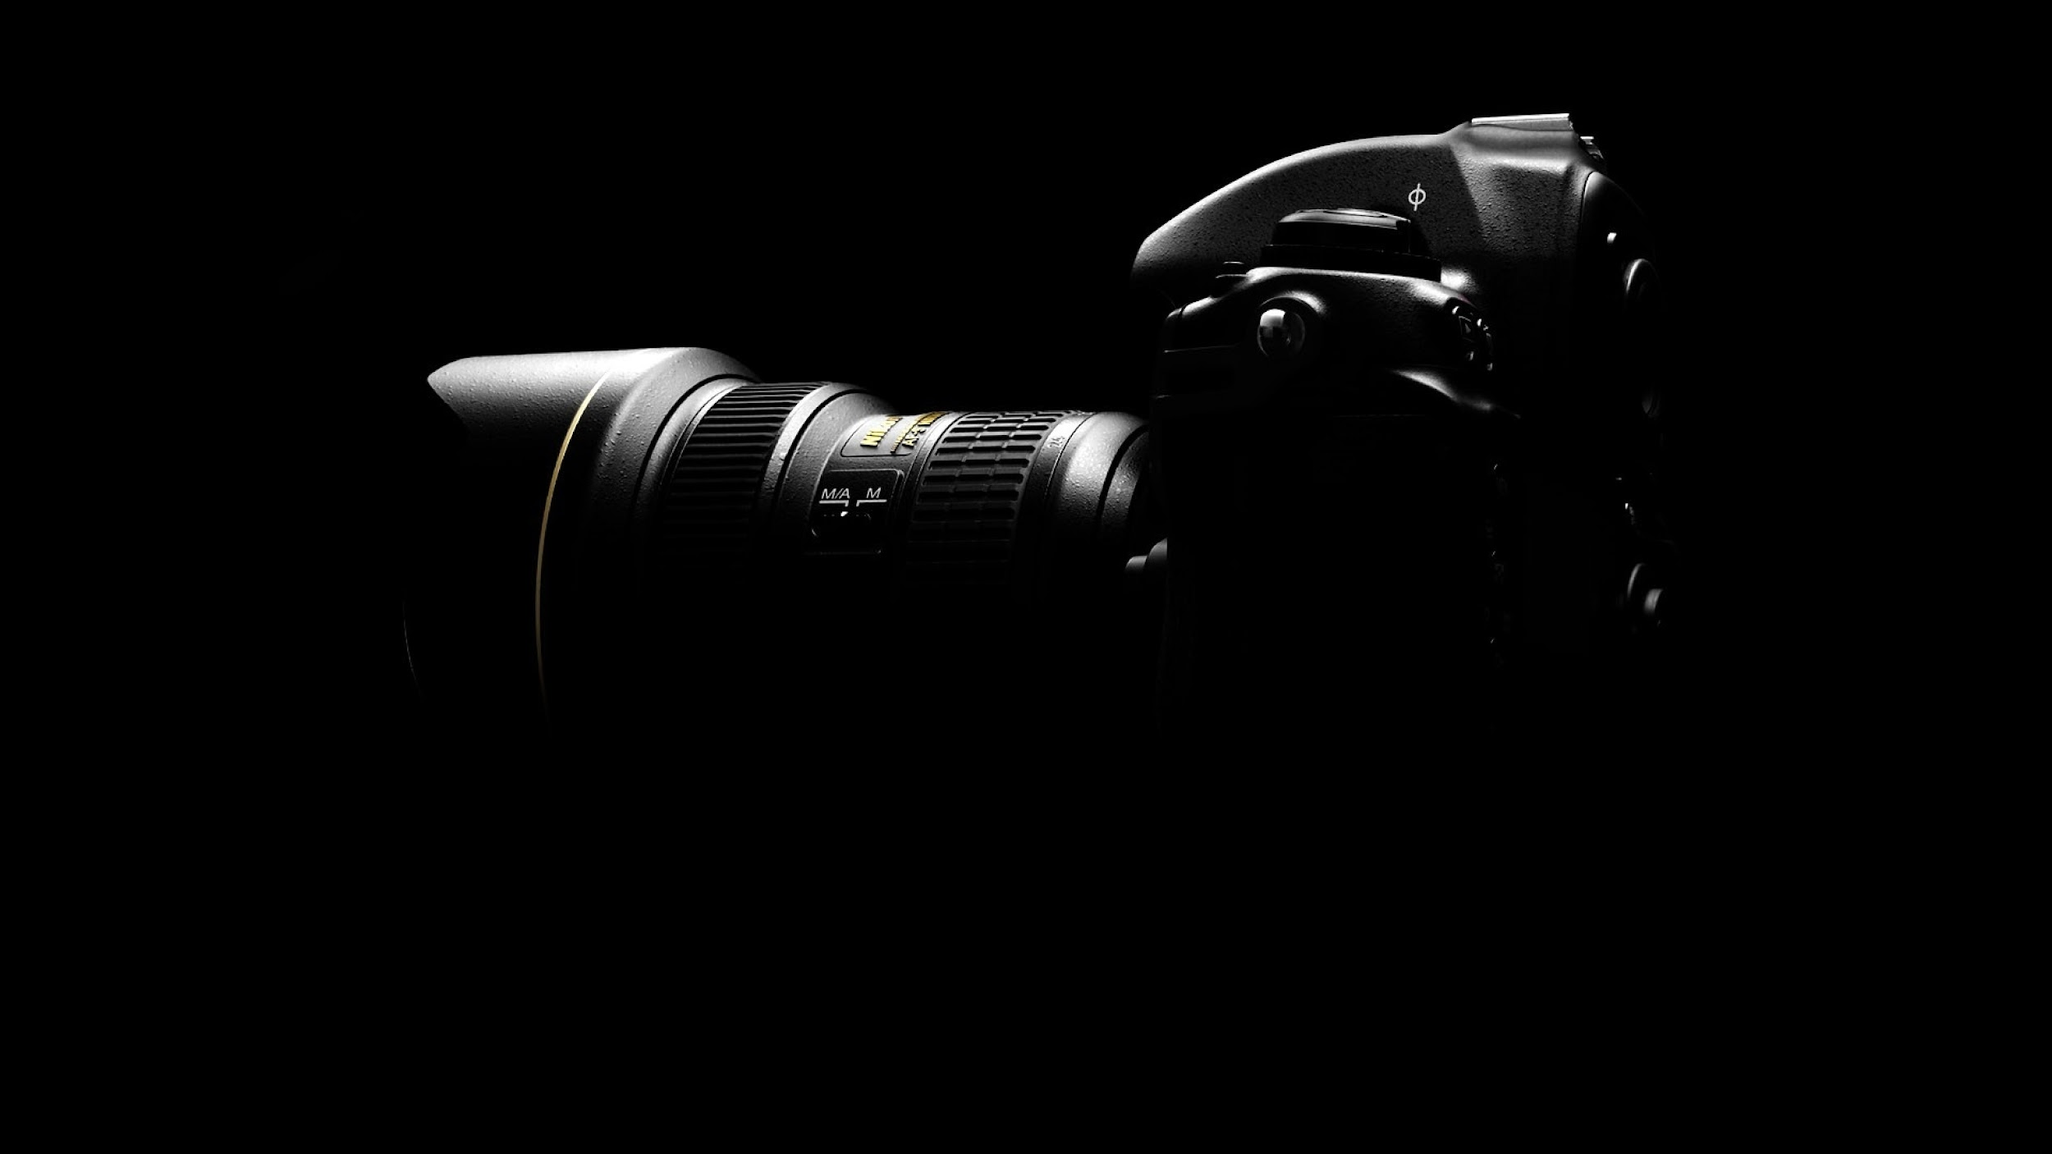

Application of Singular Value Decomposition in Image Processing
NLA SVD Team

Slide 2


TABLE OF CONTENTS
01
02
03
04
Problem Statement
METHODOLOGY
RESULTS
CONCLUSION
50MM F-0.95

Slide 3
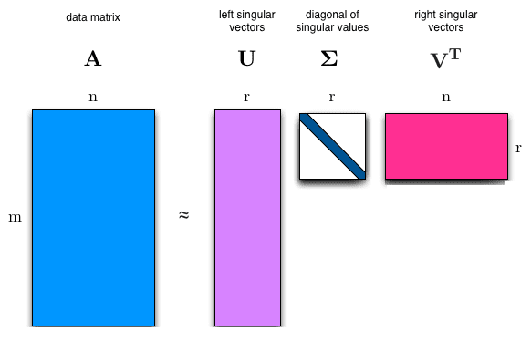
01
Problem Statement
50MM F-0.95

Slide 4
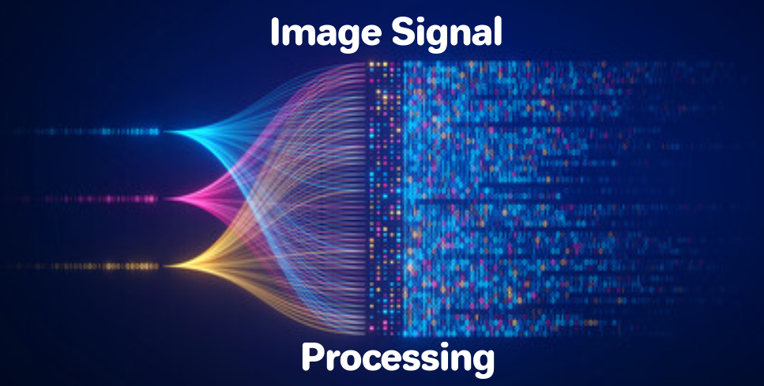

Problem statement
Problem:
Can Singular Value Decomposition (SVD) use in image denoising and image compression?
Yes!

Slide 5
Introduction
Singular Value Decomposition (SVD) is a powerful linear algebra technique widely used in various image processing applications.
In this problem statement, we will explore two key applications of SVD: denoising and image compression.
Image denoising and compression are fundamental tasks in image processing with numerous real-world applications.
Denoising involves removing unwanted noise from an image,
while compression aims to represent an image in a more compact form for storage or transmission. SVD provides a valuable tool for achieving these objectives

Slide 6
Introduction
Image denoising
it is a process of reducing or removing noise from a digital image.
Noise in an image typically appears as random variations in brightness or color, and it can be caused by various factors, such as sensor limitations, transmission interference, or environmental conditions during image acquisition.
The goal of image denoising is to enhance the visual quality of an image by reducing or eliminating unwanted noise while preserving important image features.
noise input image
processing
denoised output image

Slide 7
Introduction
Image compression
it is the process of reducing the file size of a digital image while preserving its visual quality to the extent possible.
It is particularly important in scenarios where storage capacity or bandwidth is limited.
The original image and compressed image is compared using various performance measure metric
input:
large sized
image
processing
output
compressed image
50MM F-0.95

Slide 8
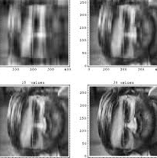
02
Methodology
50MM F-0.95

Slide 9
Methodology
Metric calculation
Calculate compression Ratio
calculate mean square Error
start
Calculate SVD
input image
vary the value of k
Compression
compress and reconstructed
image
Flowchart
denoising
apply K-SVD
Show output
show output
denoising
END
5

Slide 10
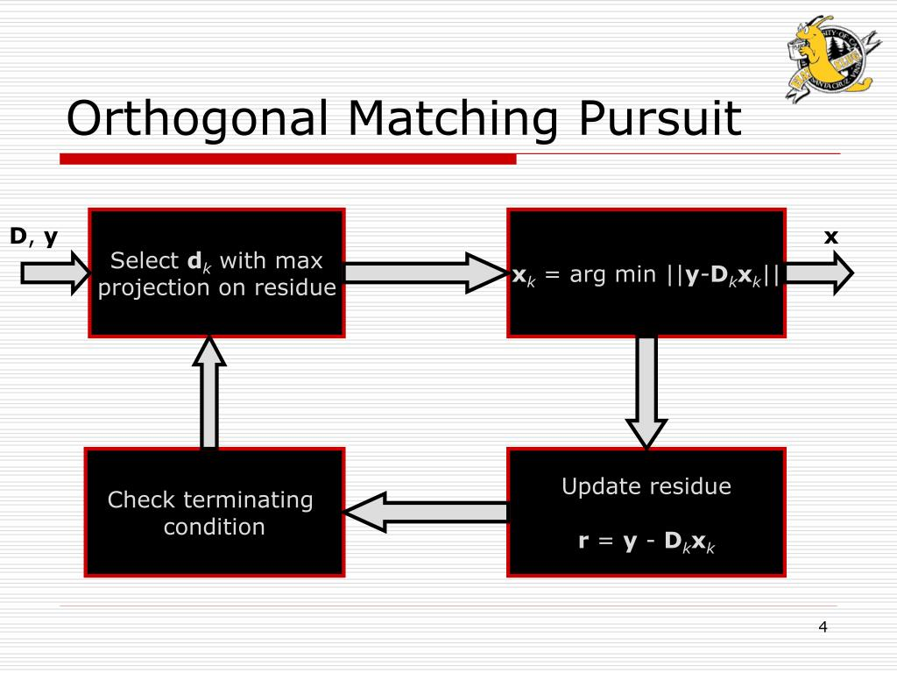
Methodology
Image denoising using SVD
For image denoising, the SVD of the image matrix is computed. We are using OMP to help for denoising. Orthogonal Matching Pursuit (OMP) is an algorithm used for sparse signal recovery.
It's commonly employed in image denoising tasks, particularly when using sparse representations like Singular Value Decomposition (SVD).
Priyam Chatterjee, “PPT - Image Denoising with K-SVD PowerPoint Presentation, free download - ID:522269,” SlideServe, Jul. 04, 2012. https://www.slideserve.com/dee/image-denoising-with-k-svd

Slide 11
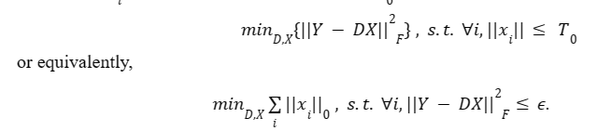
Methodology
Image denoising using SVD
One the most well-known image denoising approach is K-SVD. This is an iterative method that switches between sparse coding of the input using a current dictionary and updating dictionary atoms. It is also called “dictionary learning”. It creates a dictionary for sparse representations applying a singular value decomposition approach.
https://en.wikipedia.org/wiki/K-SVD

Slide 12
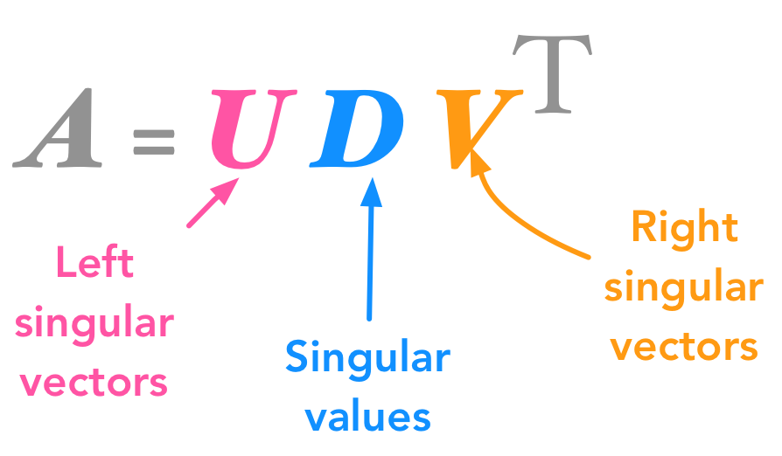
Methodology
Image compression using SVD
Computing and sending a low-rank SVD approximation of the image can considerably reduce the amount of data sent while retaining a high level of image detail.
Successive levels of detail can be sent after the initial low-rank approximation by sending additional singular values and the corresponding columns of V and U.
50MM F-0.95

Slide 13
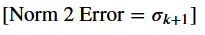
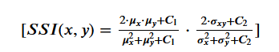
Methodology
Performance metric
metrics provide quantitative measures to evaluate the quality of the image approximation
Mean Squared Error (MSE)
Peak Signal-to-Noise Ratio (PSNR)
Norm 2 Error
Compression Ratio
Structural Similarity Index (SSI)
Compression Ratio =Original Size/Compressed Size

Slide 14
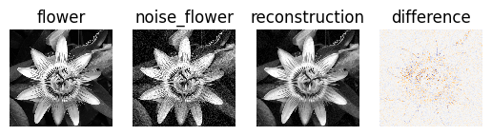
03
Results
50MM F-0.95

Slide 15

Image denoising using SVD
Dictionary learning
K-svd

Slide 16
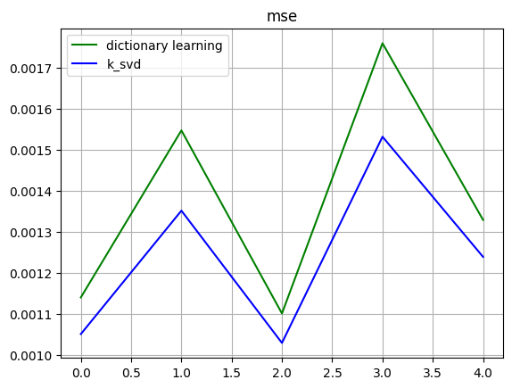
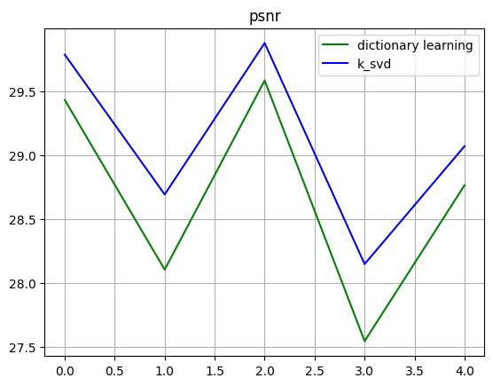
Image denoising using SVD
Comparison of dictionary learning with k-svd using mse and psnr metric performance measure

Slide 17
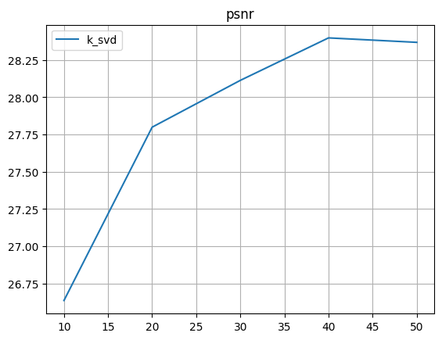
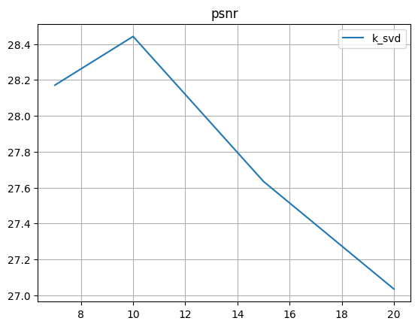
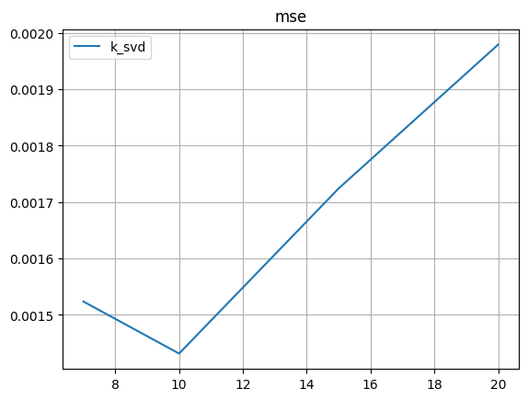
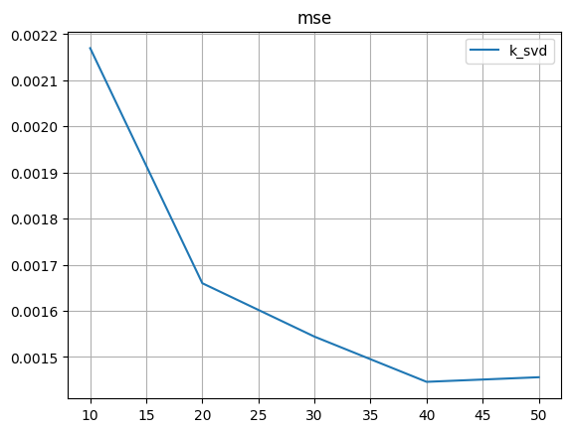
Image denoising using SVD
Varying number of patch size for one image.
Best result at patch size=10.
Varying number of components for one image.
Best result at components =40

Slide 18
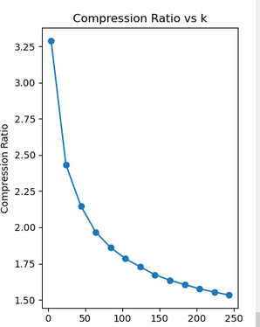
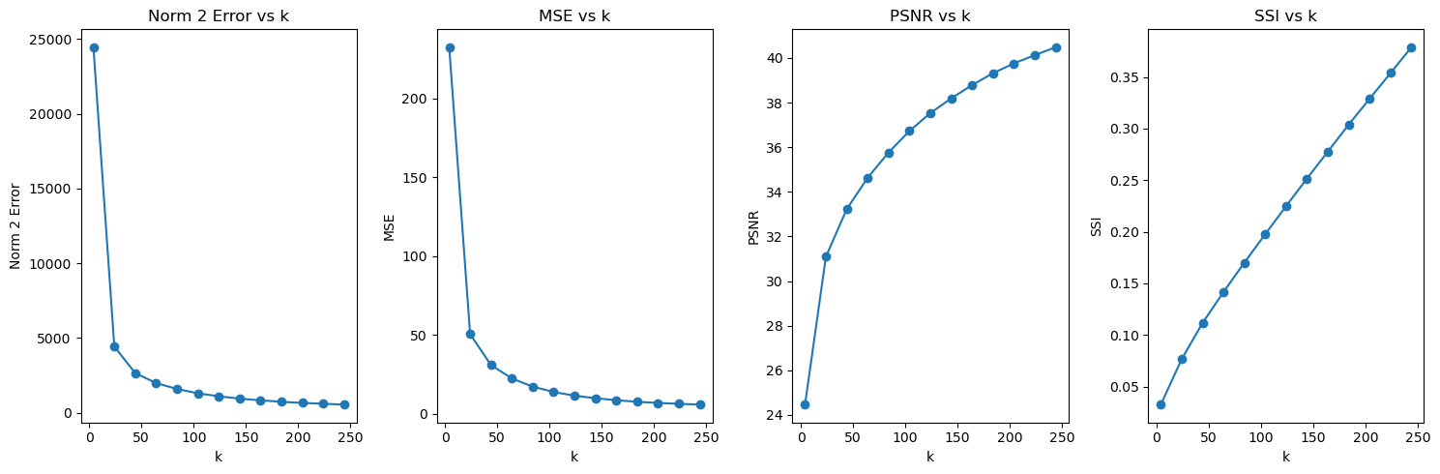
Image compression using SVD
performance measure metric for compression
graphical output
50MM F-0.95

Slide 19
Image compression using SVD
Results and data analysis
Size of original image(kB) | K values | Compression ratio | Size of Compressed image(kB)
737.25 | 4 | 3.29 | 224.09
737.25 | 24 | 2.43 | 303.11
737.25 | 44 | 2.15 | 343.05
737.25 | 64 | 1.97 | 374.52
737.25 | 84 | 1.86 | 396.13
737.25 | 104 | 1.78 | 413.13
737.25 | 124 | 1.73 | 426.79
737.25 | 144 | 1.67 | 440.94
737.25 | 164 | 1.63 | 450.94
737.25 | 184 | 1.60 | 459.4
737.25 | 204 | 1.58 | 467.83
Table:1
This table shows the compression value at different k values
50MM F-0.95

Slide 20
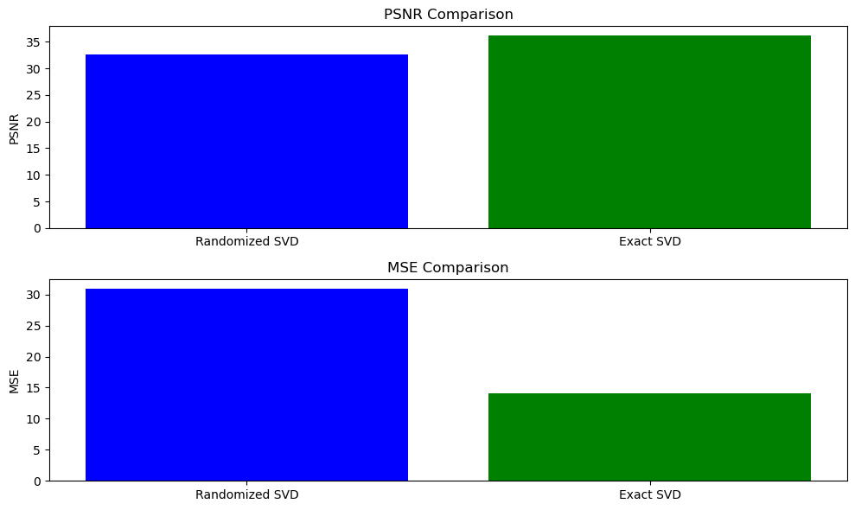
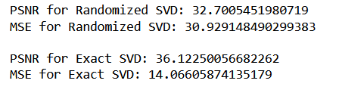
Image compression using SVD
Results
comparison between exact SVD and randomised svd.
50MM F-0.95

Slide 21
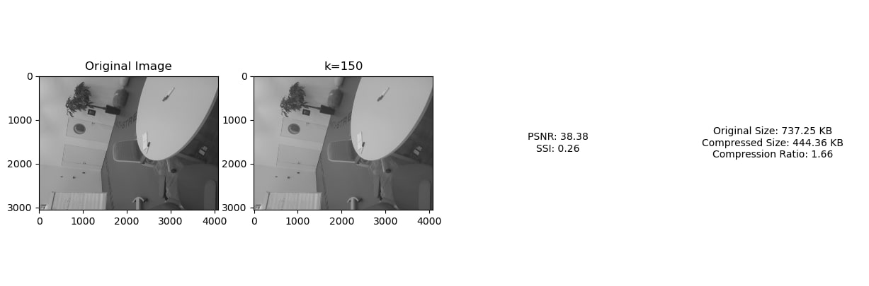
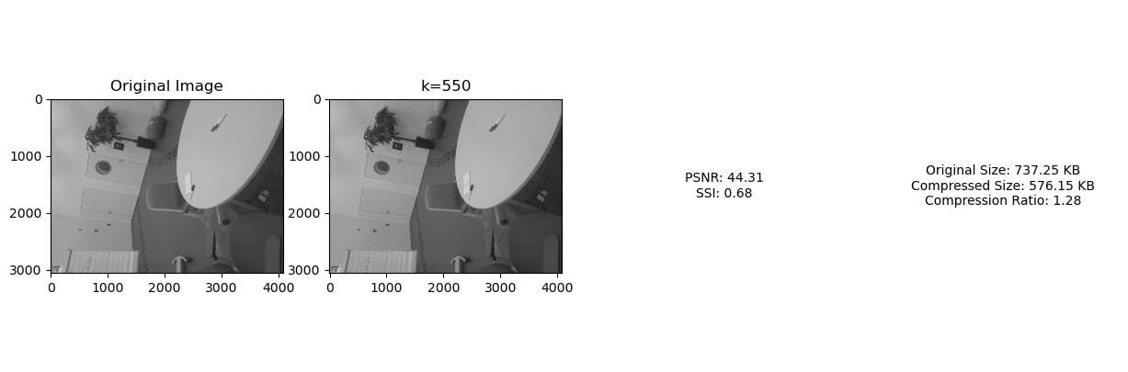
Results

Slide 22
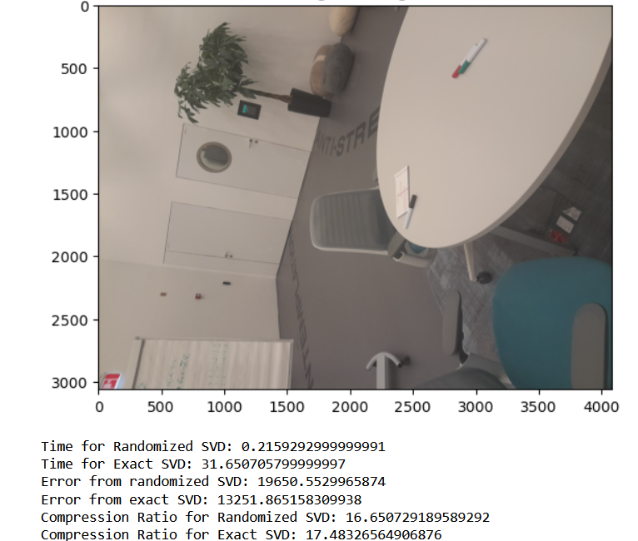
Results
continue…
Comparison between Randomised svd and exact svd in terms of time complexity.
Randomised svd is computationally efficient.

Slide 23

04
Conclusion
50MM F-0.95

Slide 24
Conclusion
In image compression,as the value of k increases , compression ratio is decreases, in other words, for small k, CR is high.for small k, image quality is low.
So as the value k increases, image quality increases. that is smaller MSE and Larger PSNR
Combining dictionary learning and SVD gives better results. In comparison both metrics PSNR and MSE shows that k-SVD is more precise.
Comparison of different patch size shows that after particular point, quality of method decrease. Increasing the number of components shows that quality of k-SVD increases.
50MM F-0.95

Slide 25
Conclusion
In conclusion, the continuous advancement of image compression and denoising techniques is vital for addressing the evolving demands of modern applications, where efficient resource utilization, real-time processing, and high-quality visual information are paramount.
The synergy between compression and denoising methods contributes to the creation of robust solutions for a wide range of practical scenarios.
50MM F-0.95

Slide 26
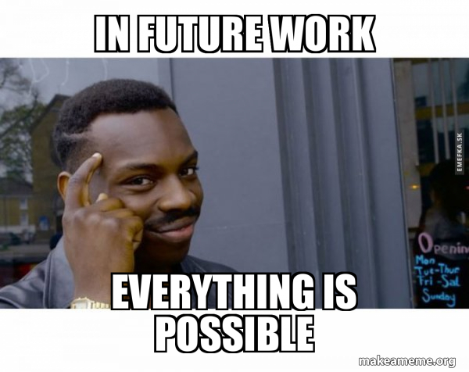
Future Work
Future work could involve exploring the application of SVD in specific domains such as medical imaging, satellite imagery, and security systems. Additionally, investigating hybrid approaches combining SVD with deep learning techniques may provide enhanced denoising and compression capabilities.
50MM F-0.95

Slide 27

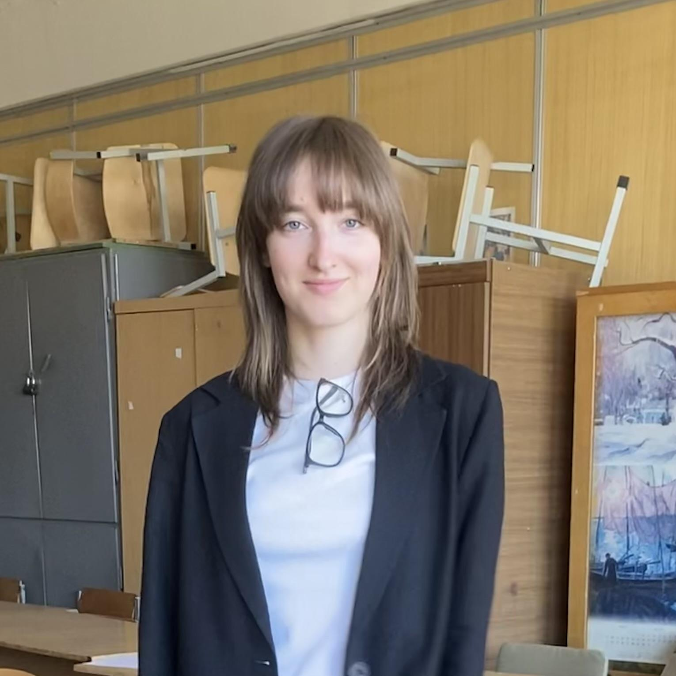

Addisu Zena
Anna Ermakova
Pattapon Tanankakorn
Team members
Image compression using SVD
Image denoising using SVD
Github repository,Readme and Powerpoint
50MM F-0.95

Slide 28
Thank you for your attention and questions time!

